Slide 1
SMART COMMUNITY
TEAM #6:
LAVANYA KANDUKURI(011833588)
NIKHILA GALALA(012468456)
DIVYA THAZHATHETHIL(012458875)
PRADNYA THORAT(012418393)

Slide 2
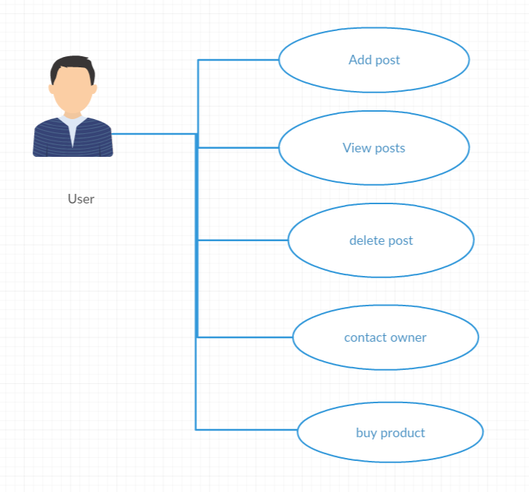
INTRODUCTION
Our website enables users in a community to effectively purchase and sell products.
User in a Community can view the latest posts, contact the seller directly in the website to buy, sell or rent a product.
User in one Community can also notify users in other community about their posts

Slide 3
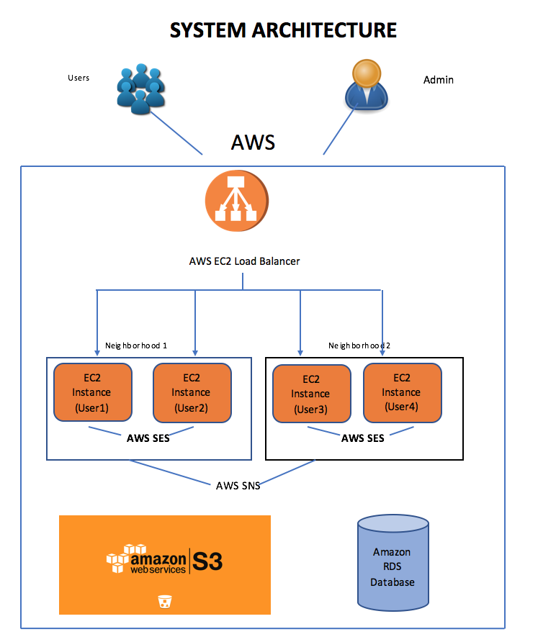
PROJECT DESIGN
AWS Simple Emailing Service(SES): For communication between users in the same community (Intra Community Communication)
AWS Simple Notification Service(SNS): For communication between the users in the other community (Inter Community Communication)
AWS S3: Used to store and retrieve all the images posted in the add
AWS RDS: Used to store the data for user login and adds
AWS EC2: The application will be deployed on several EC2 instances which can access S3 and RDS

Slide 4
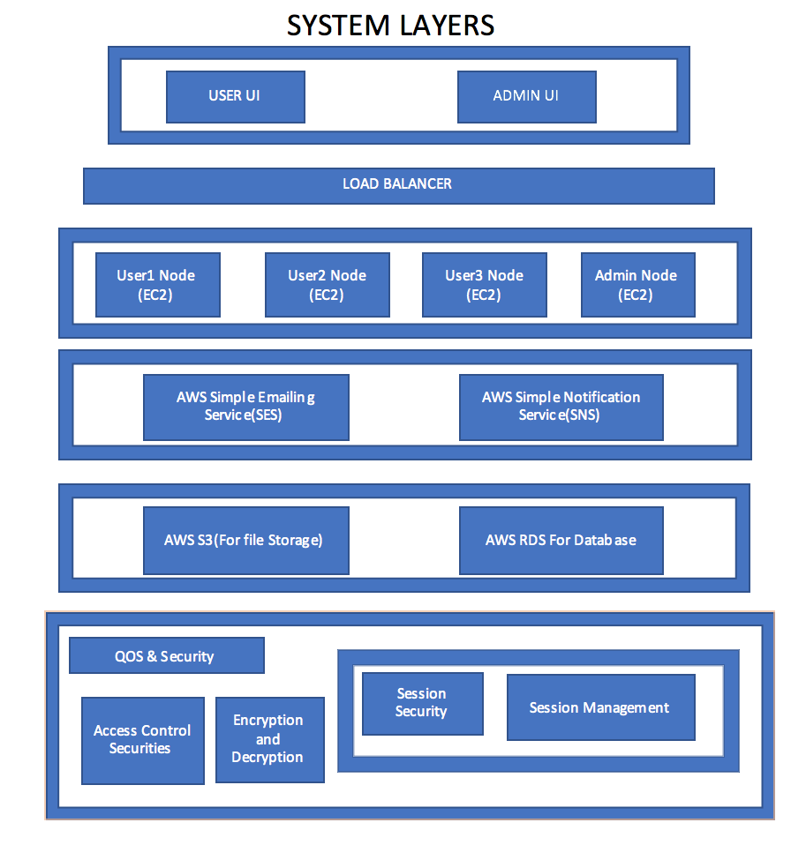

Slide 5
PROJECT COMPONENTS/PARTITIONS
Community Management Component
Dashboard Component
DB Component
Work flow service component
Messaging Component

Slide 6
BASIC FUNCTIONS OF THE APPLICATION
Module | Description
Login and logout | User: A user can login to the application using login page.
Registration | User: A user can register himself to the system in a community
Add post | User: A user can add a post to the system for selling.
View post | User: A user can view or delete his own posts.
View all posts | User: A user can view the post from all the communities which are made public.
Contact owner | User: User can contact the owner of the product for further discussions
Buy the product | User: User can then buy the product.
Delete Post | User: User can delete the post if it is not required to be shared anymore.
Create Community | Admin: Admin creates a new community for the users to register.
Update Community | Admin: Admin can select the community to be updated and change the name of the community.
Delete Community | Admin: Admin can delete a community.
Remove Users | Admin: Admin can remove users at any time from any community.

Slide 7
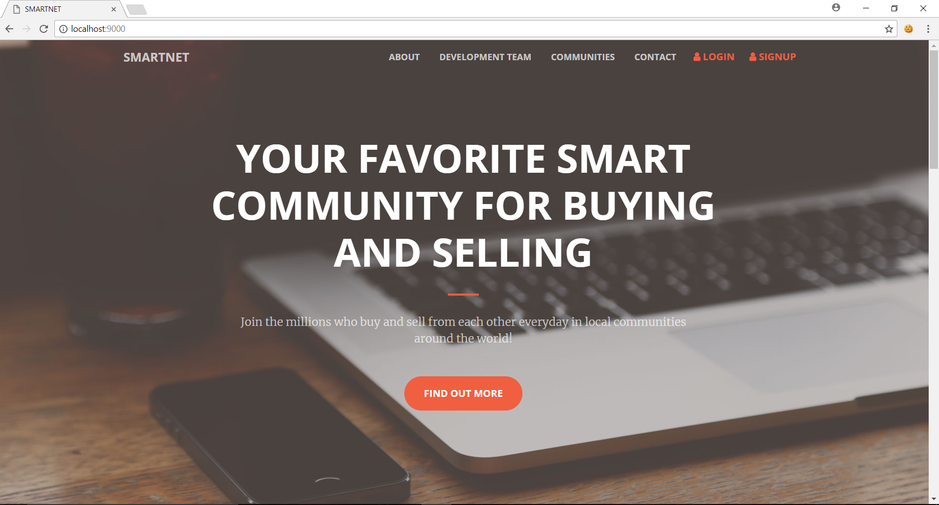
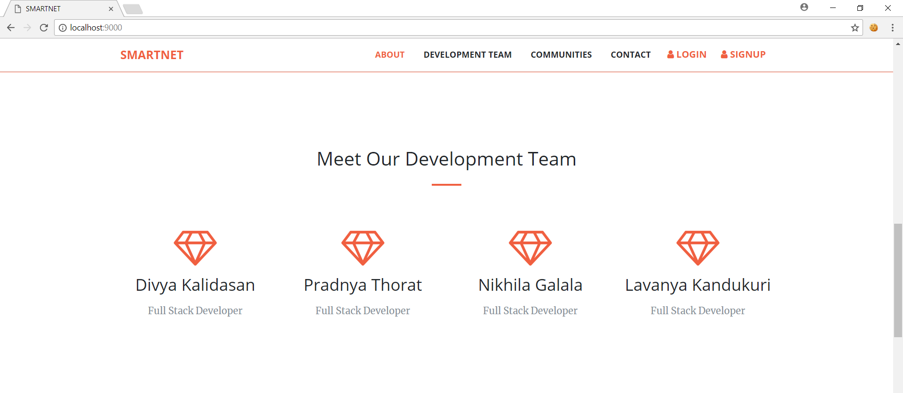
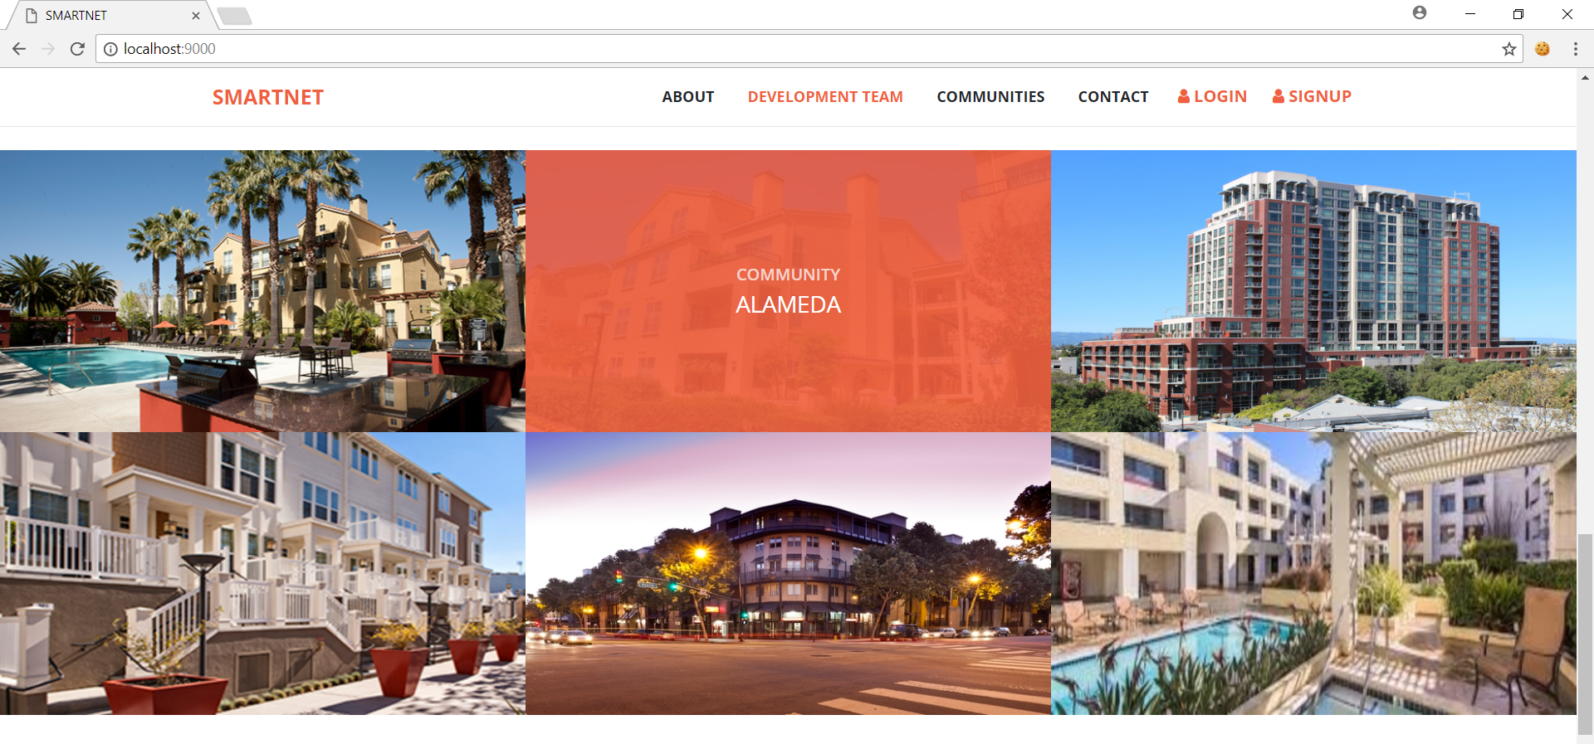
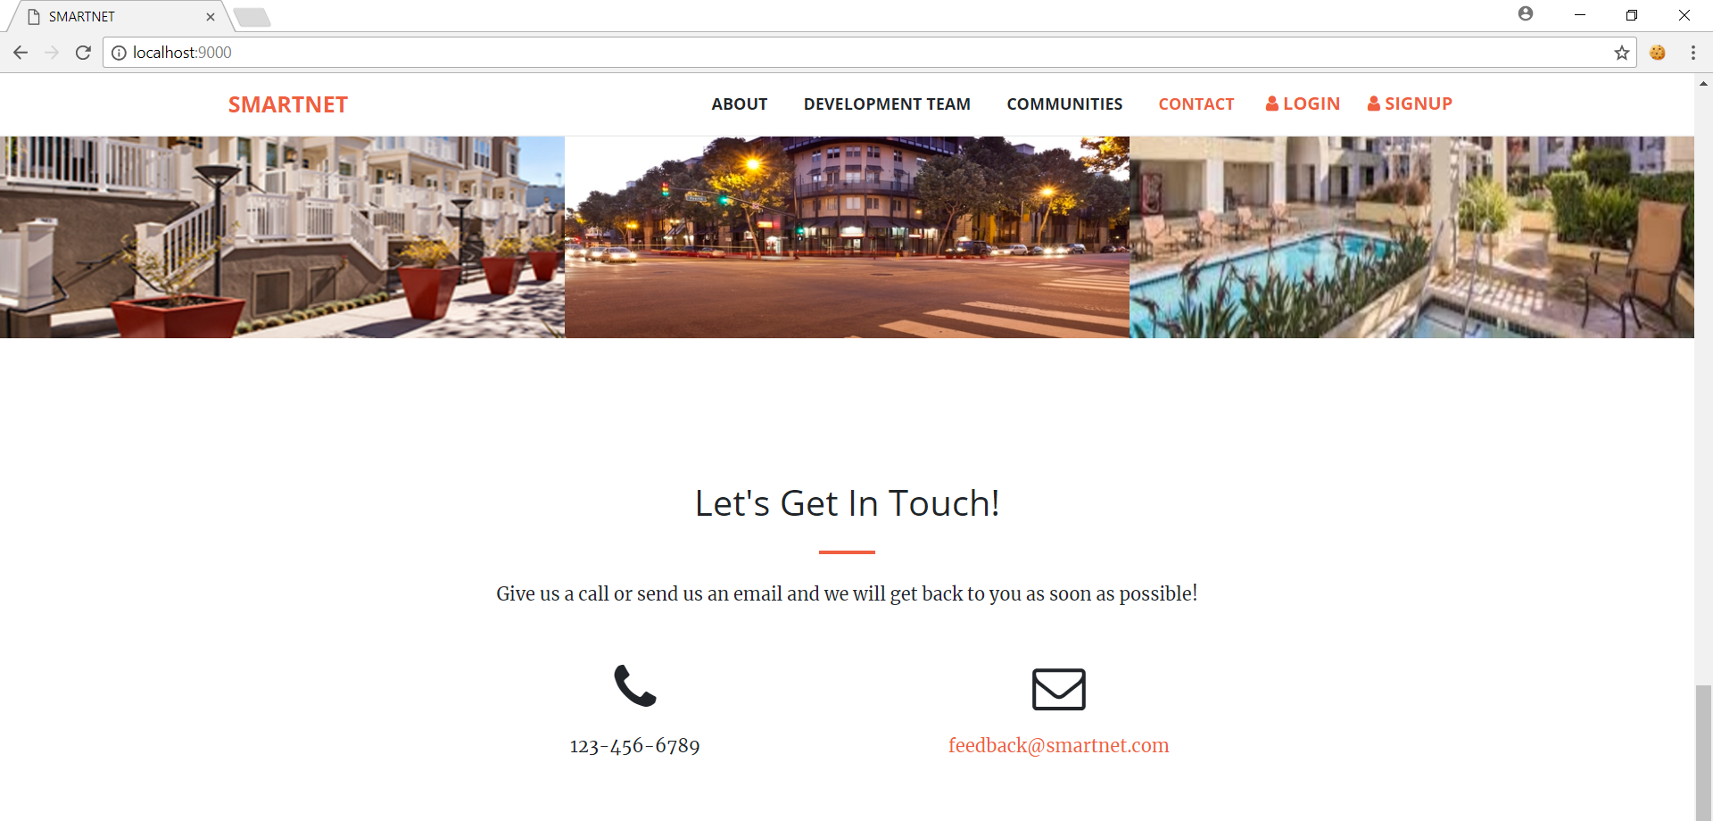
GUI for Home:

Slide 8
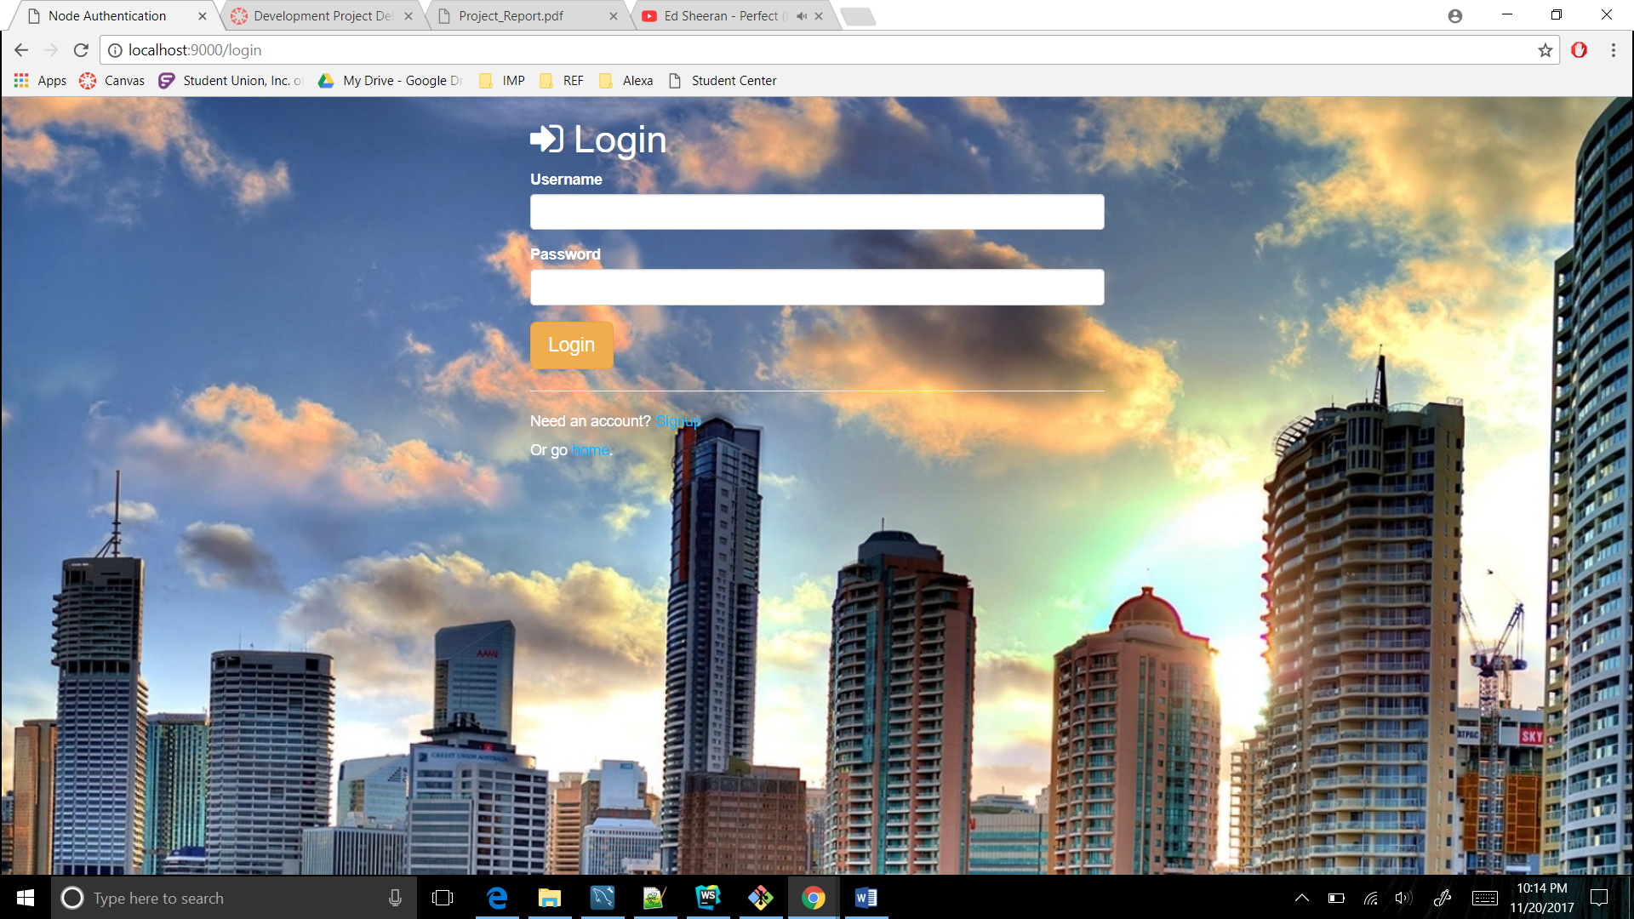
GUI for User/Admin Login:

Slide 9
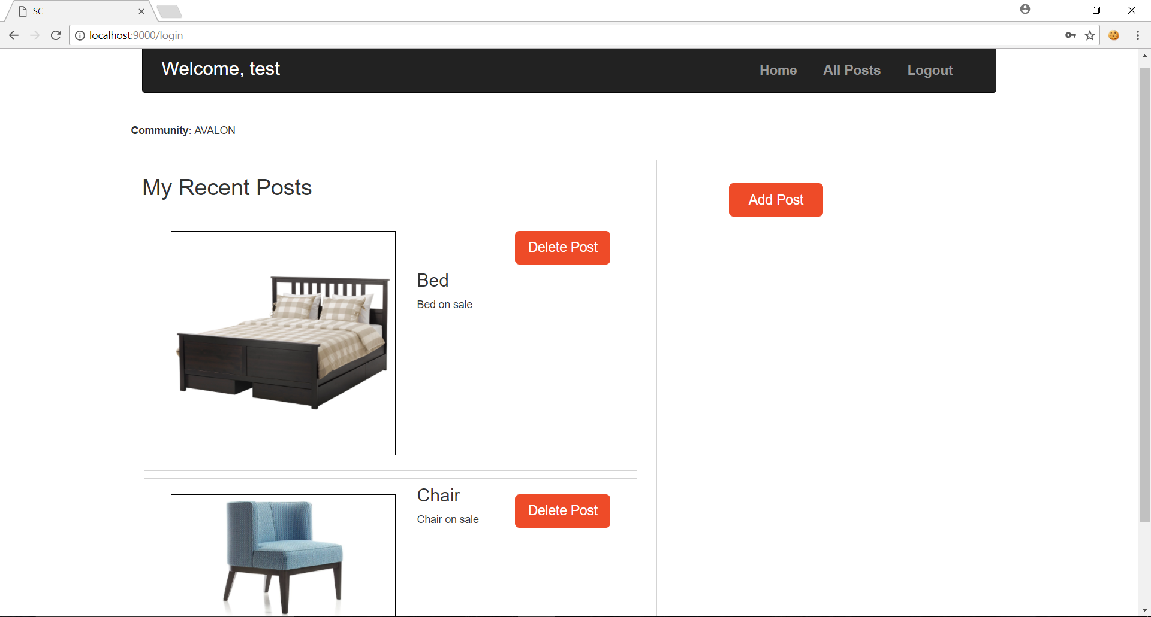
GUI for Dashboard:

Slide 10
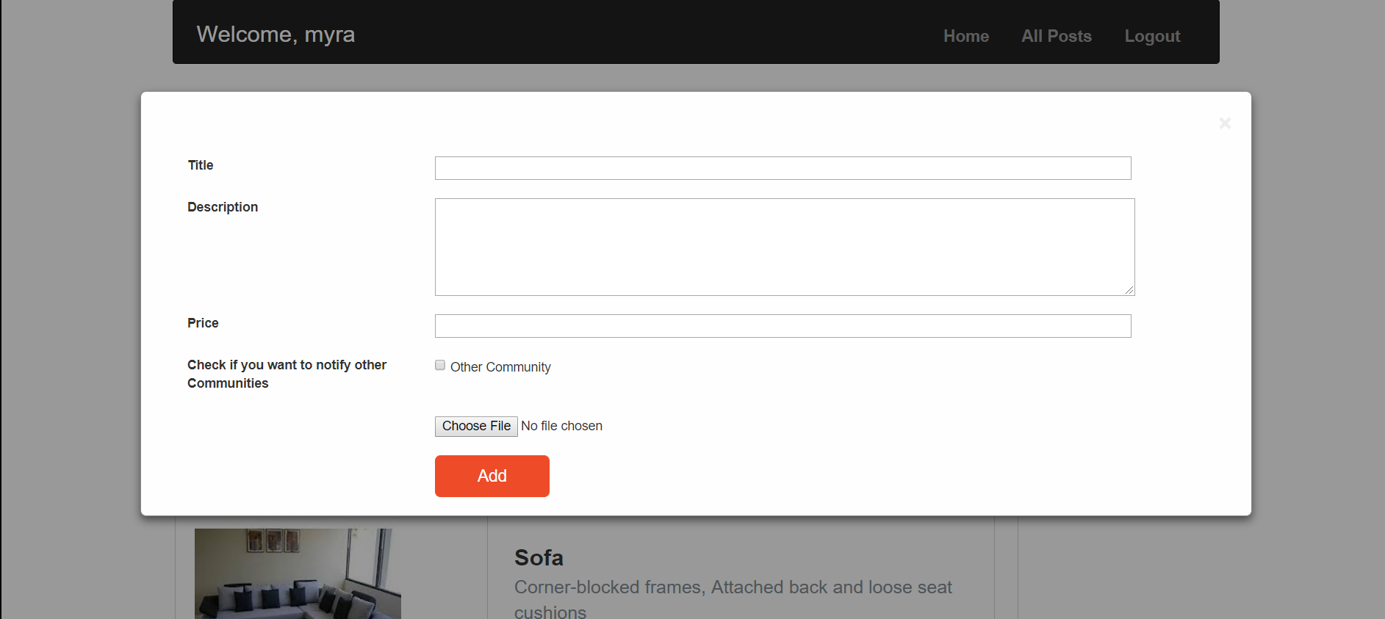
GUI for Dashboard Add a new Post:

Slide 11
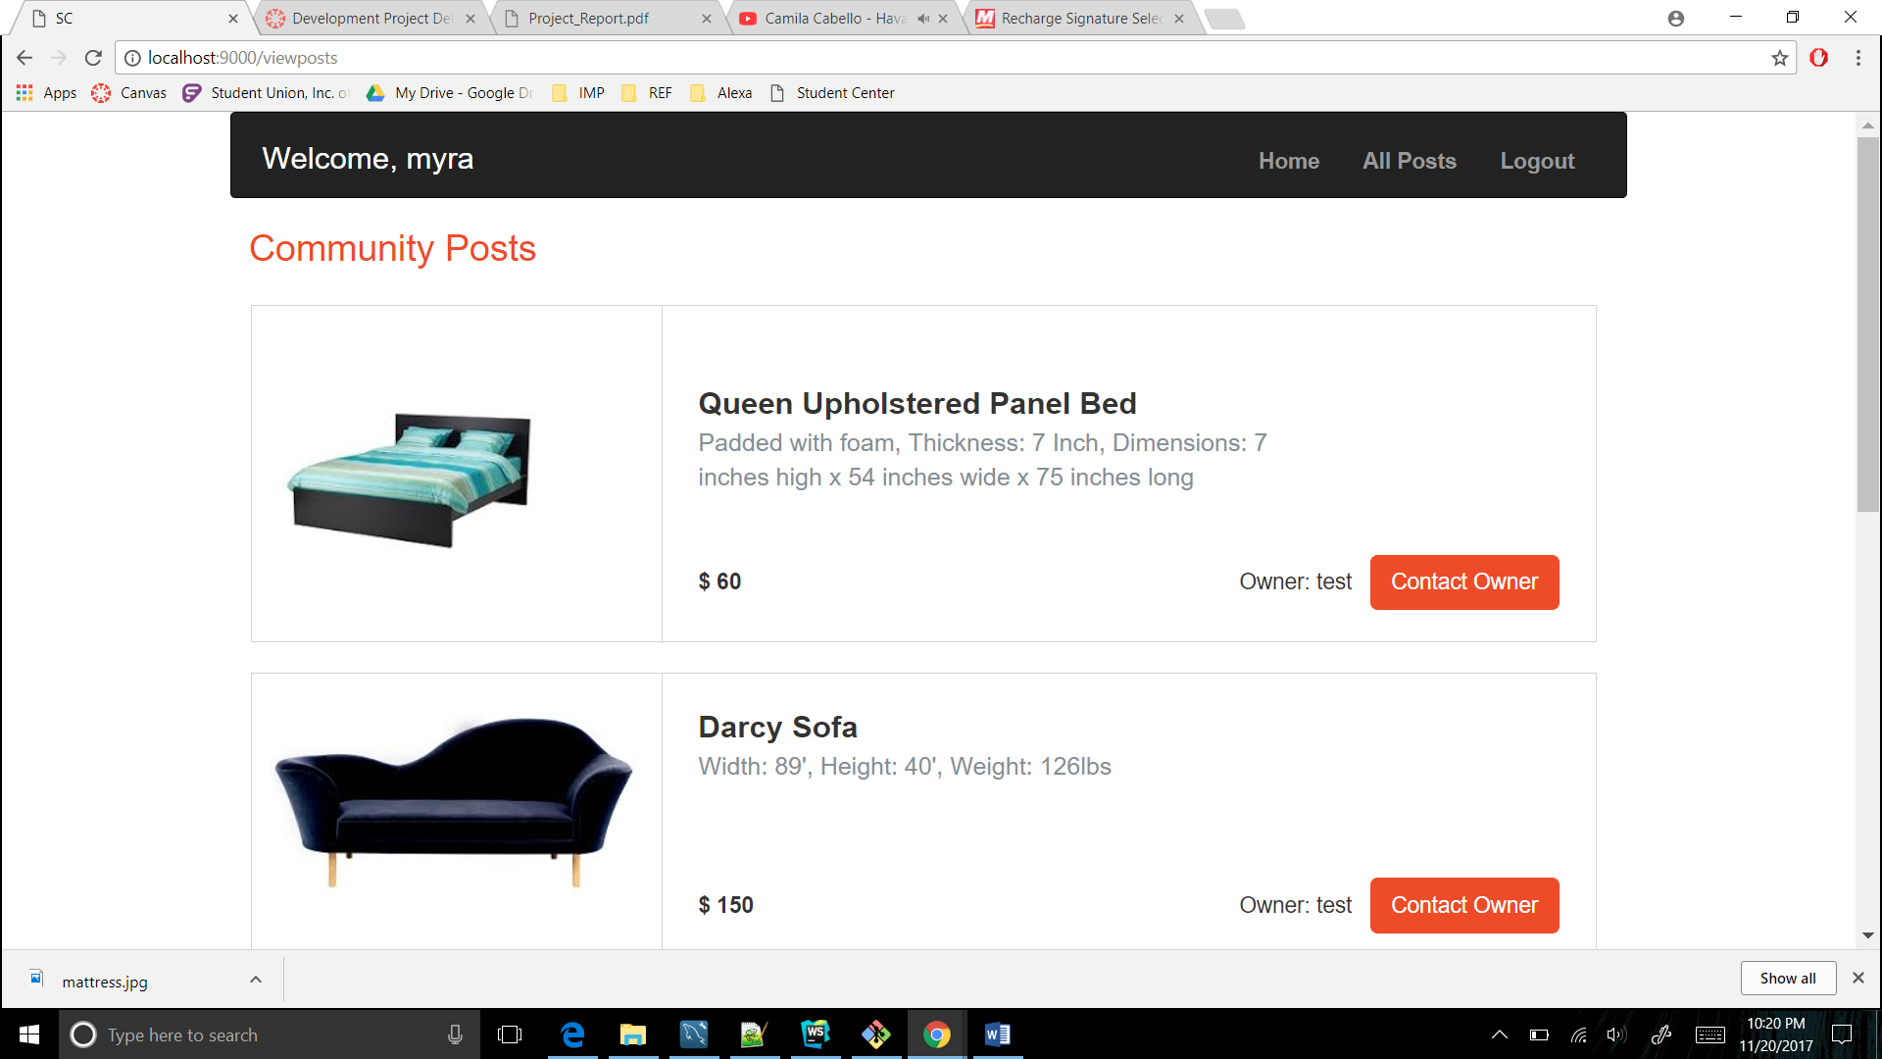
GUI for Community Posts

Slide 12
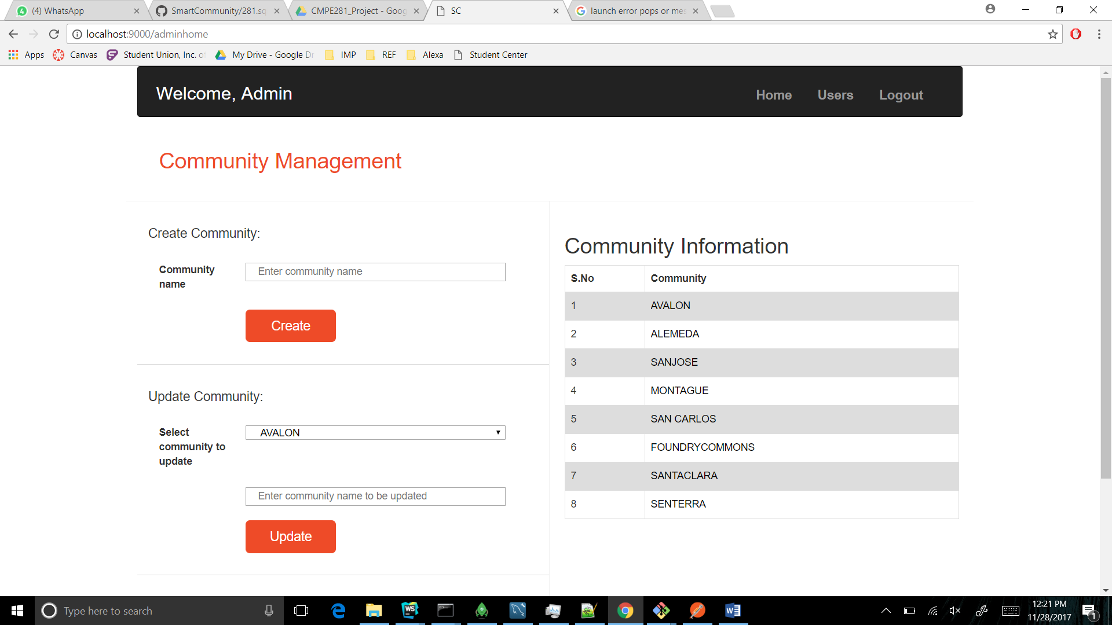
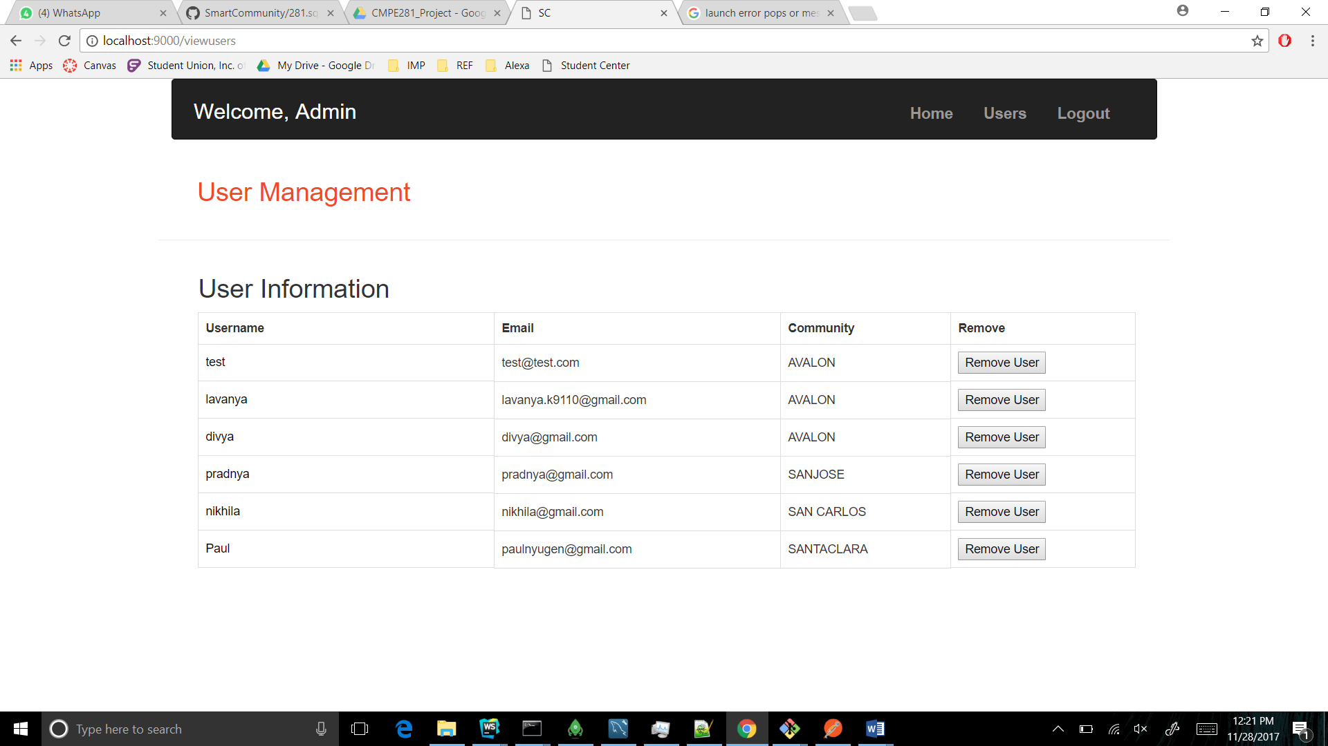
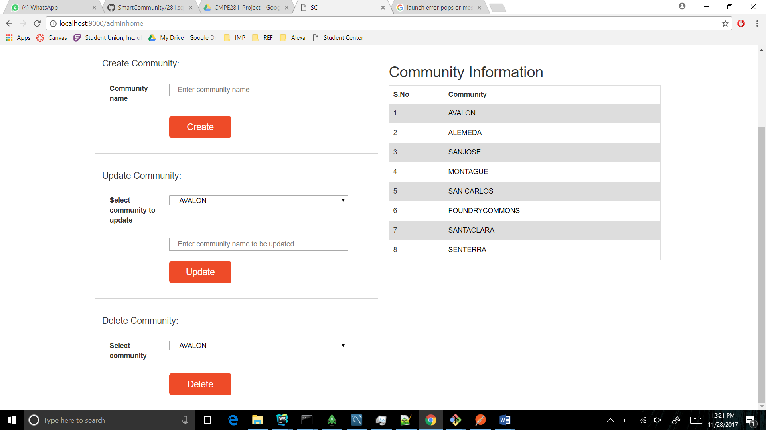
GUI for Admin/Community Management Module

Slide 13
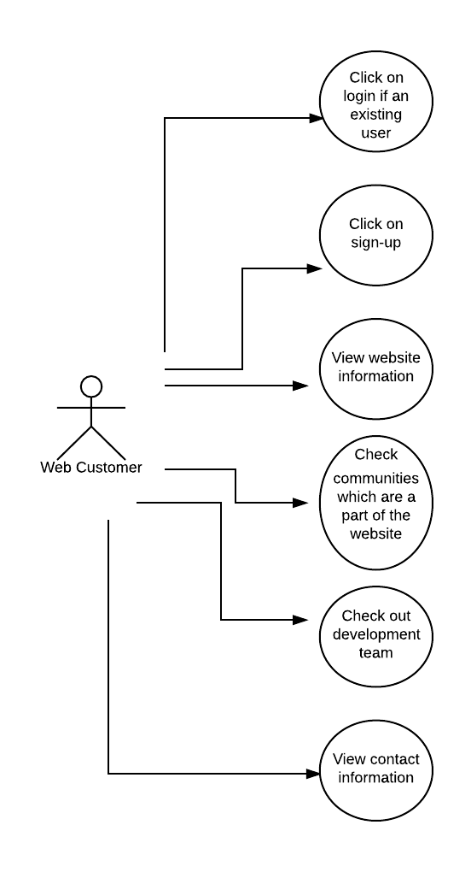
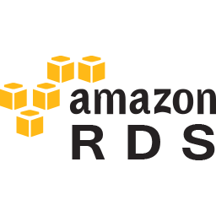
DB Component:

Slide 14
DB Component:
Table Name | Field | Functionality
communities | id | Unique id for each community
 | community | Community name
users | id | Unique id for each user
 | username | User name
 | email | email id provided by the user during sign-up
 | password | password provided by the user during sign-up
 | community | community name of which the user is a part of
 | is_admin | to check the user role(whether user is admin or not)
Table Name | Field | Functionality
posts | id | Unique id for each post
 | username | Name of the user who has created the post
 | imagepath | Path of the image uploaded for the post
 | title | Title for the post
 | description | Description provided for the post
 | access | To check if the post has access in the other communities
 | community | To store the community name of the user
 | price | To store the price of the item on sale in the post
 | quantity | To store the quantity of the item on sale in the post

Slide 15
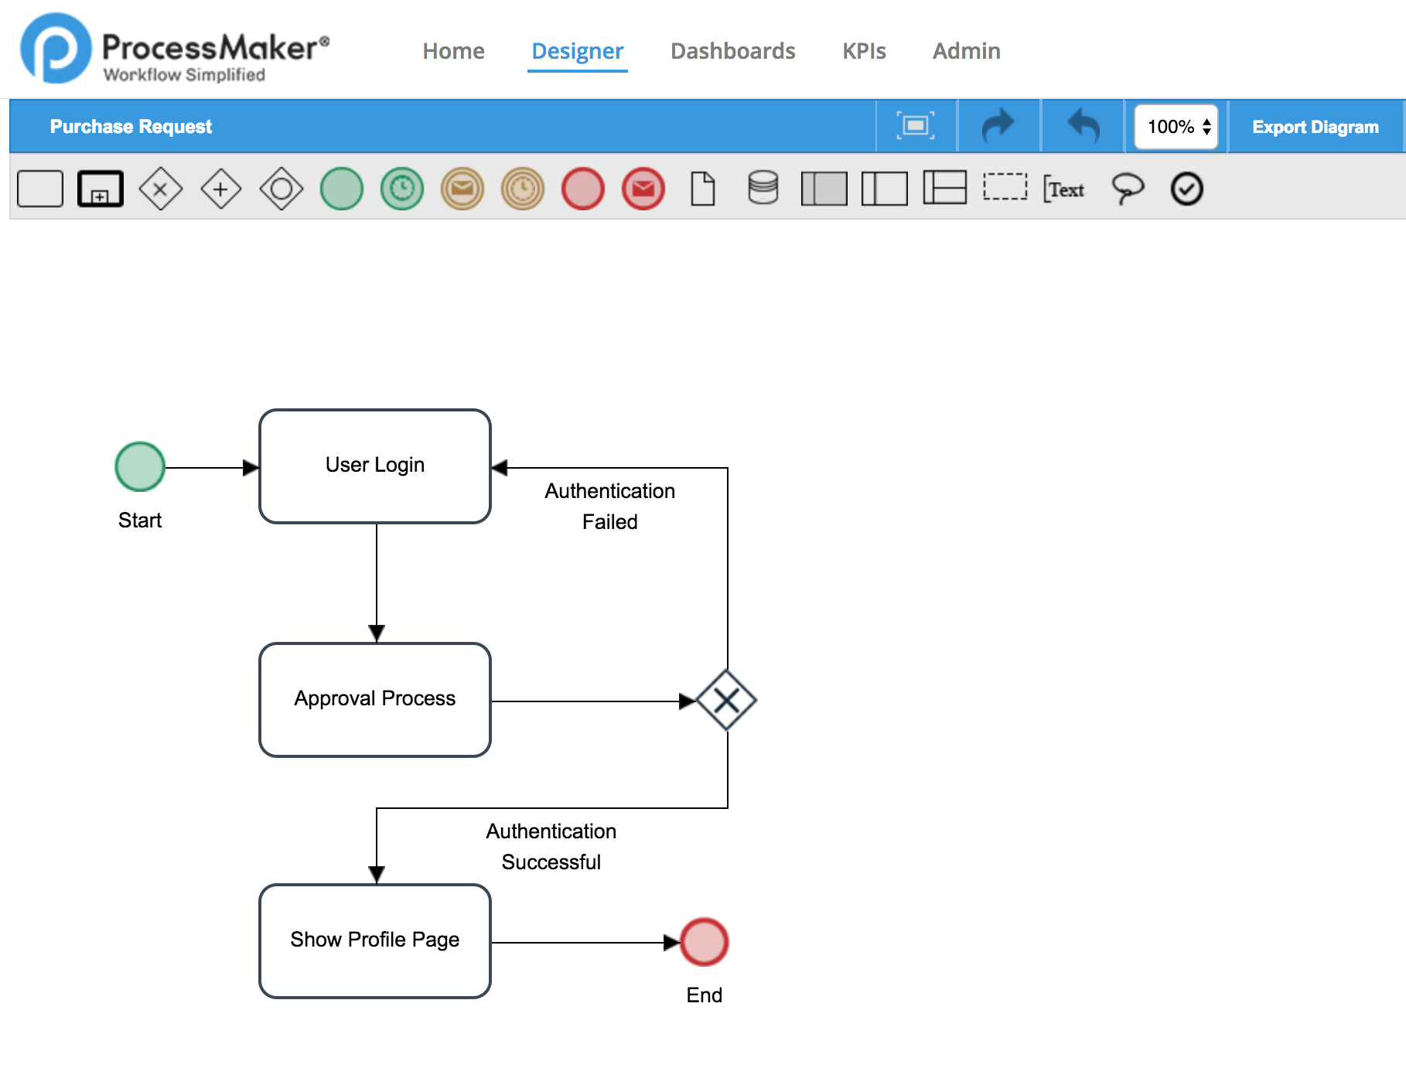
Work Flow Service Component using Process Maker User Login Workflow

Slide 16
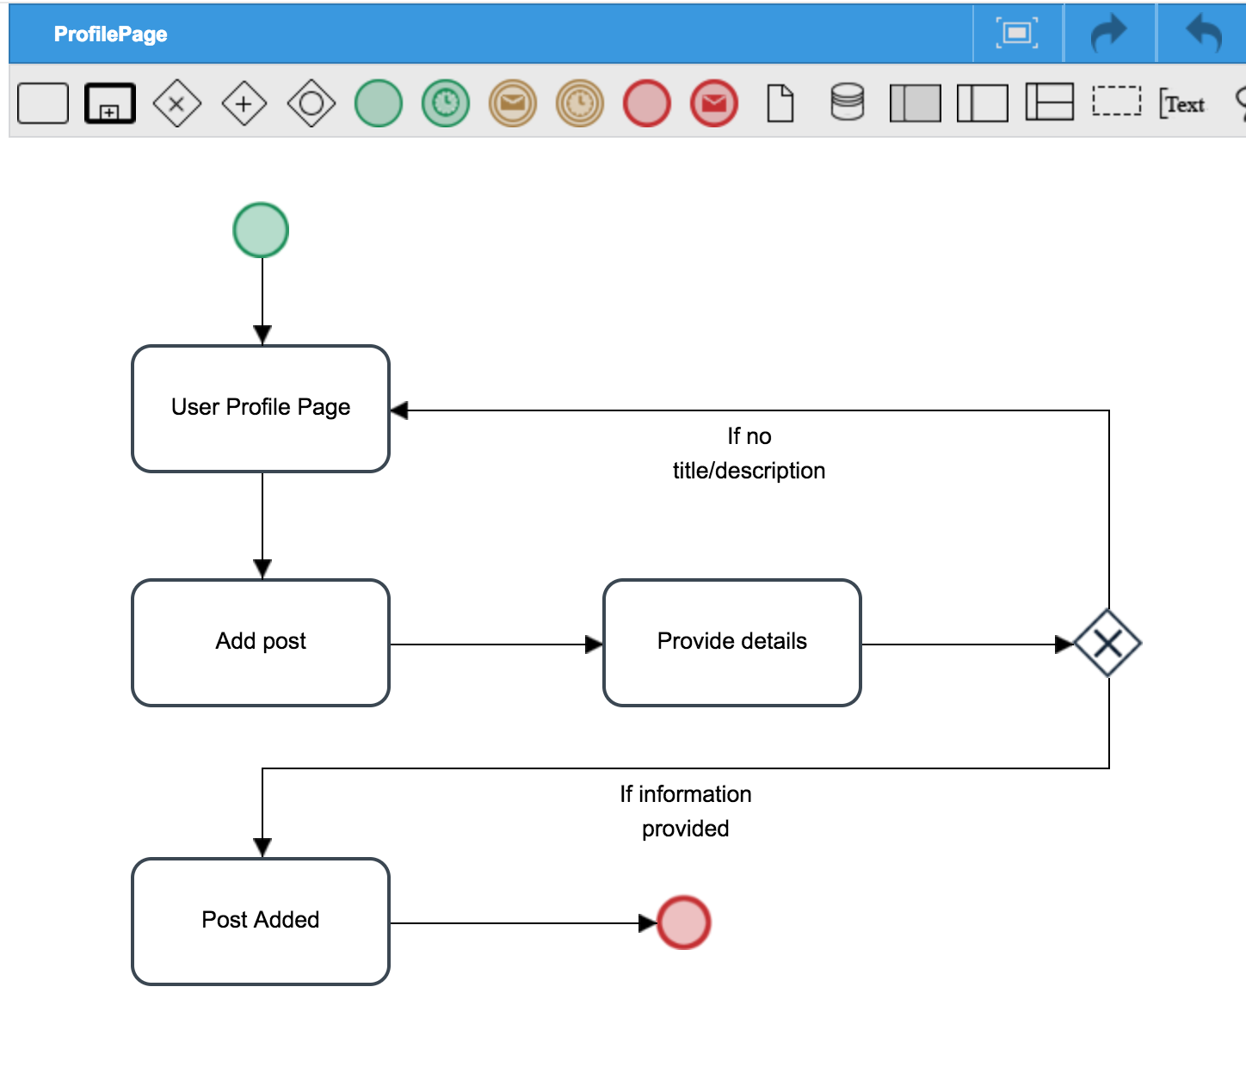
Add Post Workflow

Slide 17
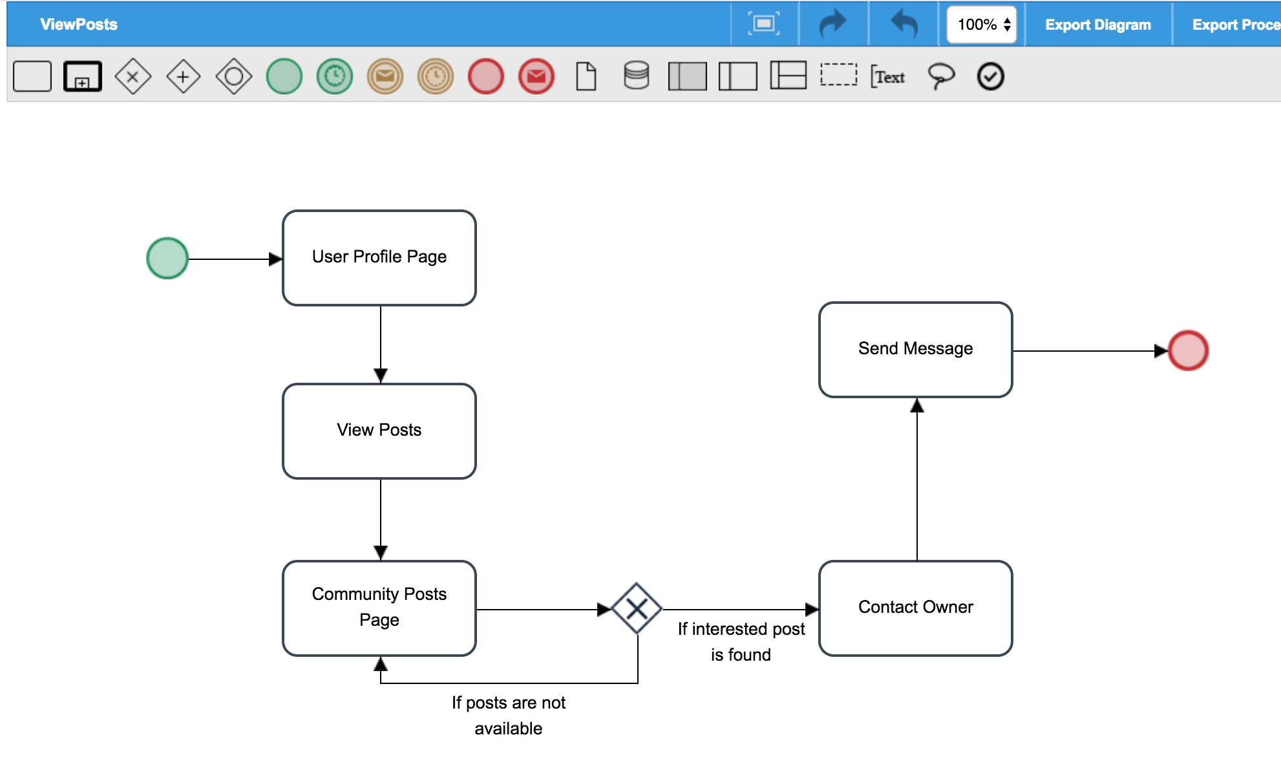
Messaging Component Workflow

Slide 18
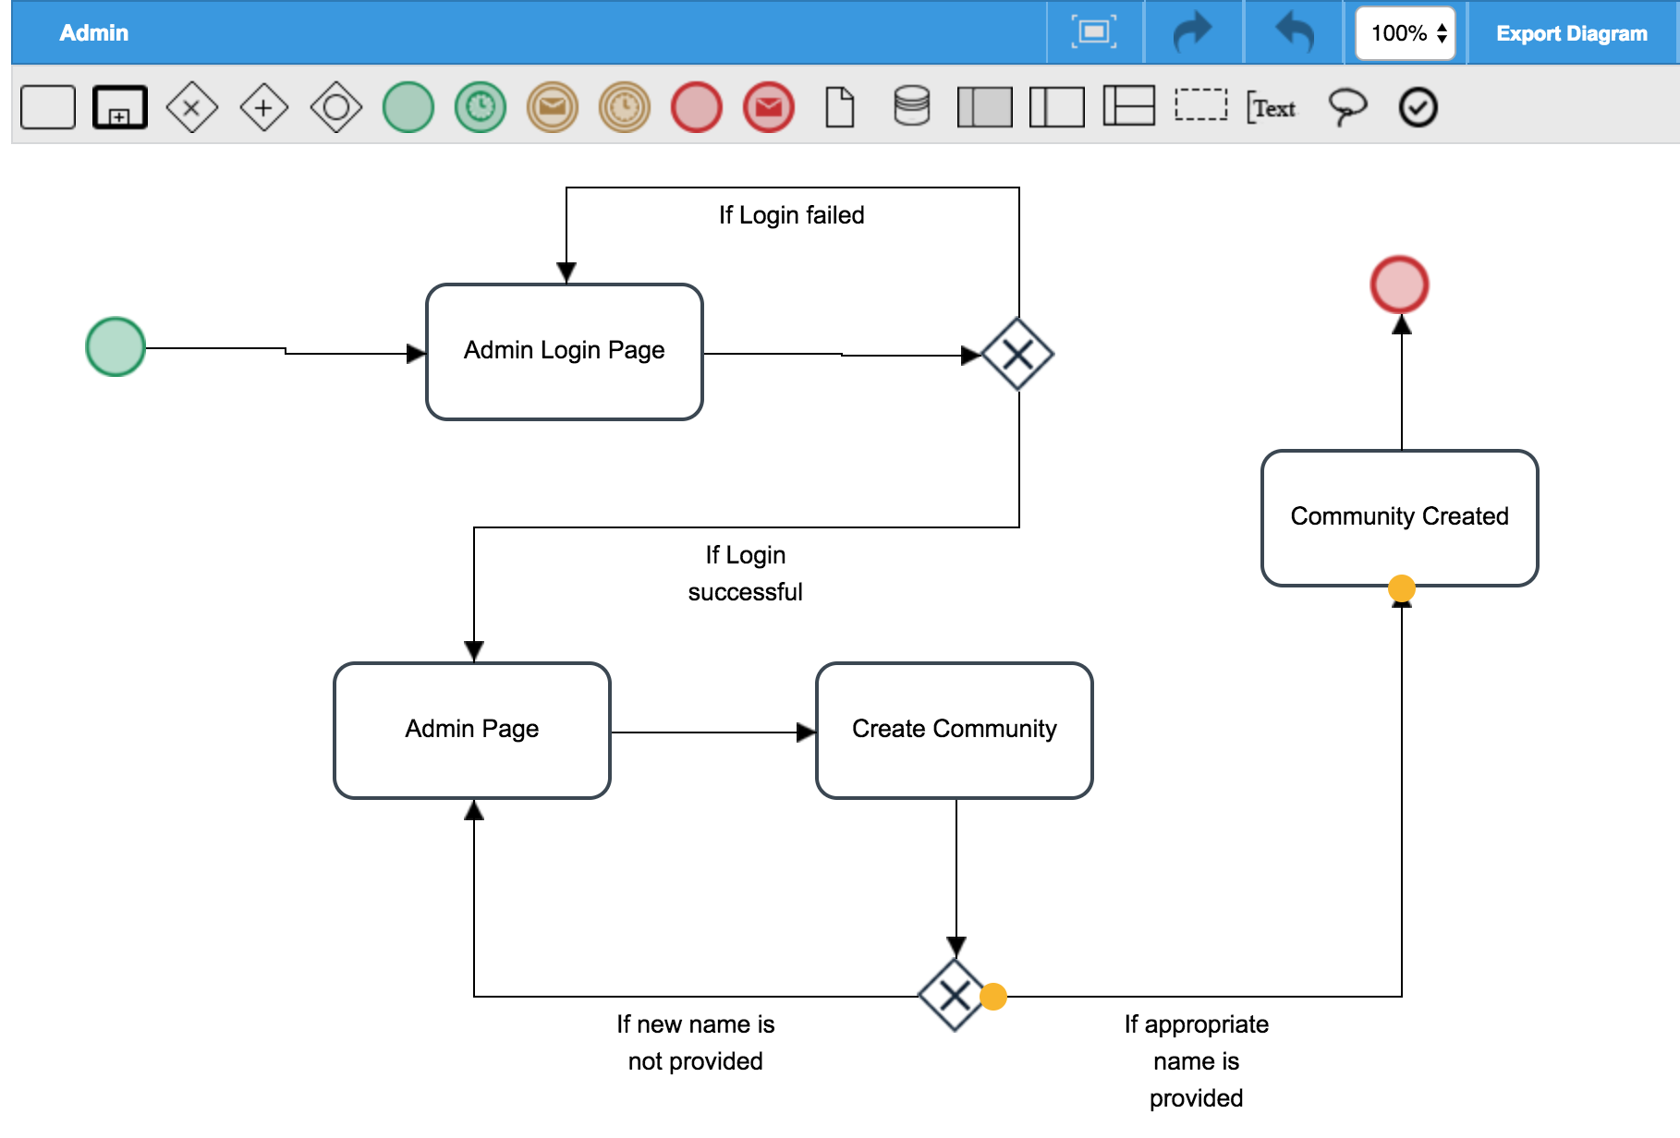
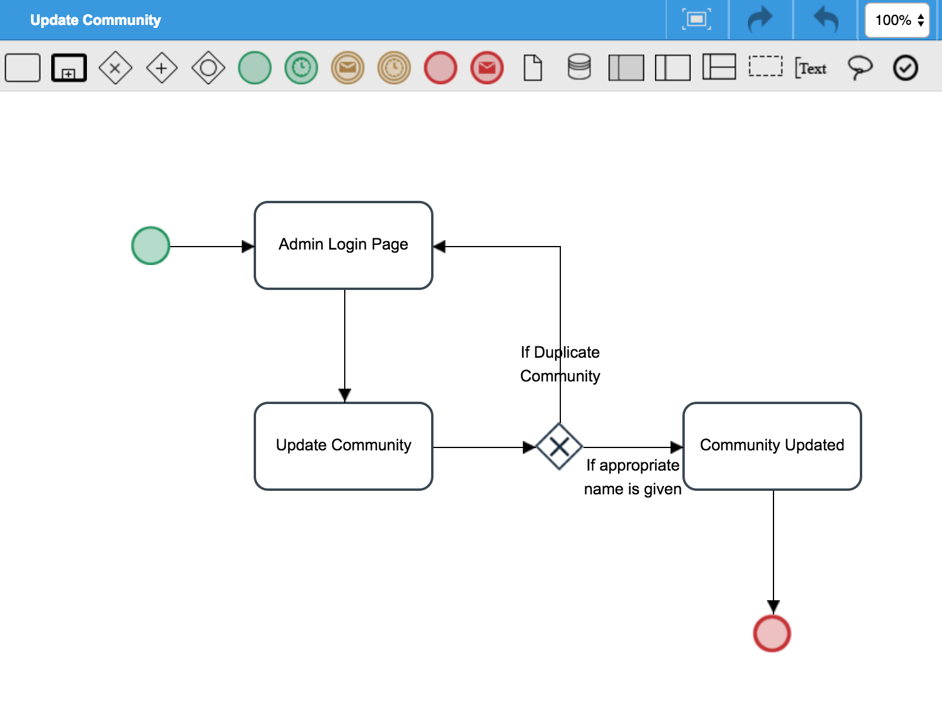
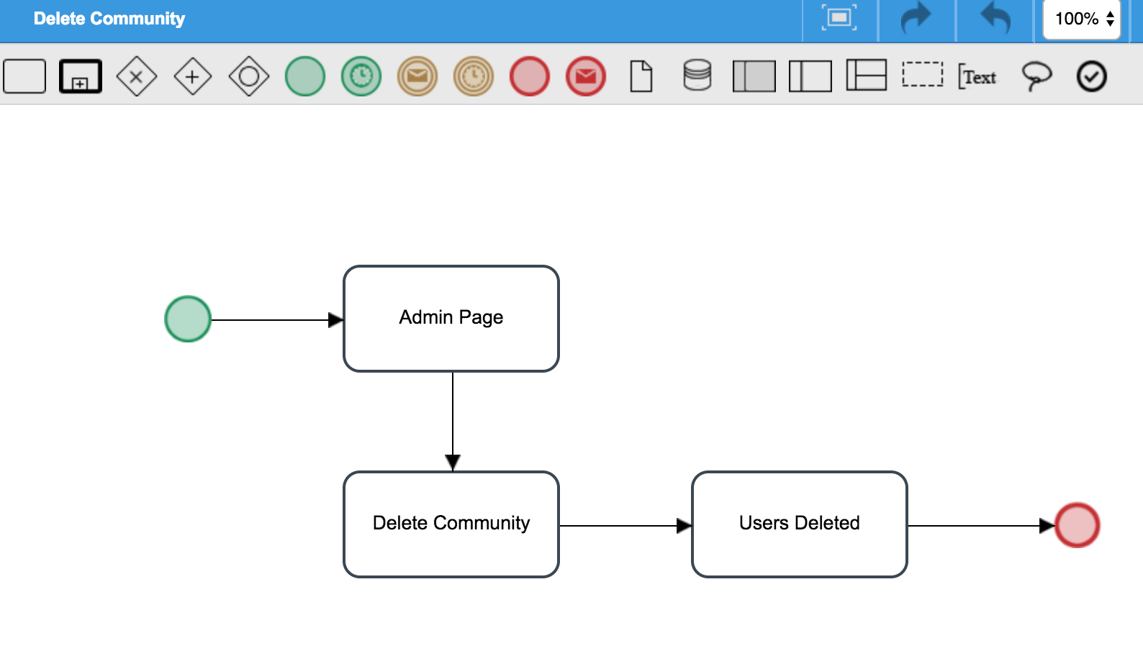
Community Management Workflow

Slide 19
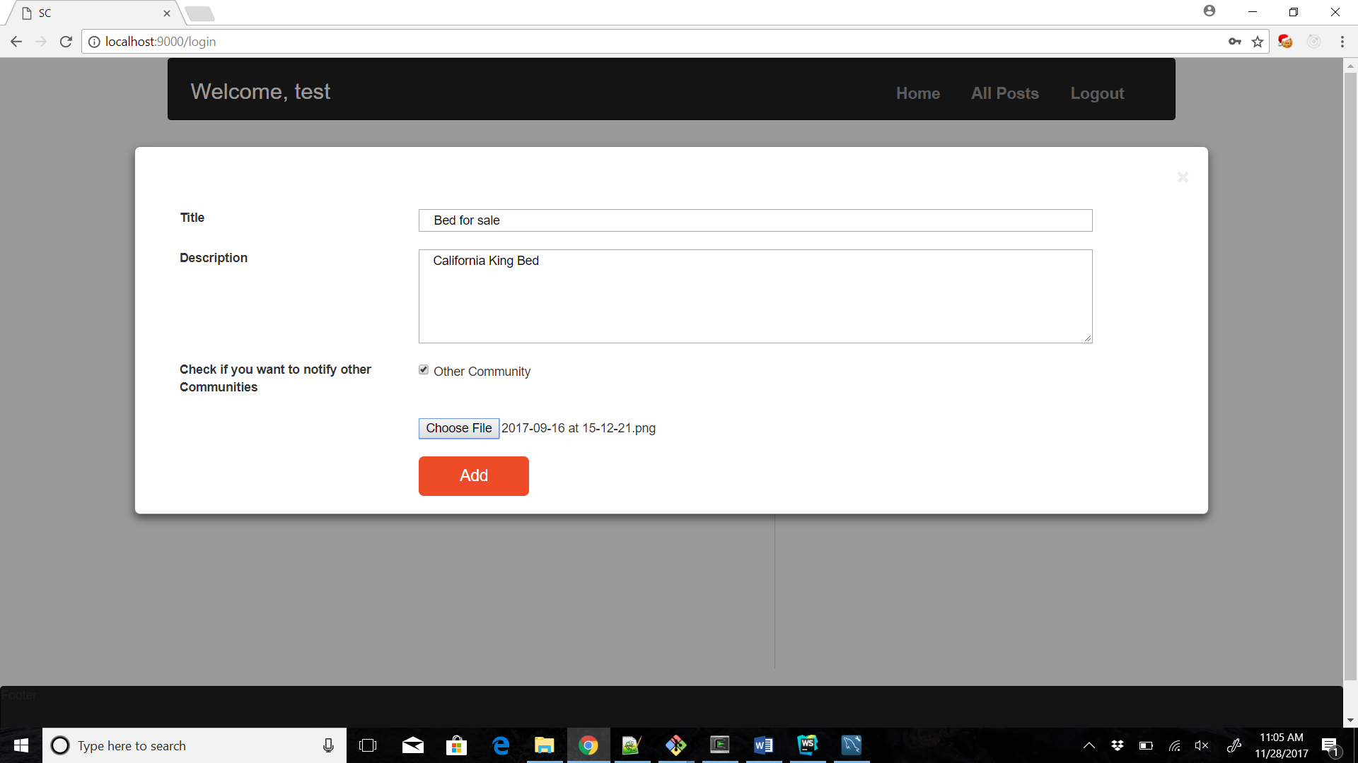
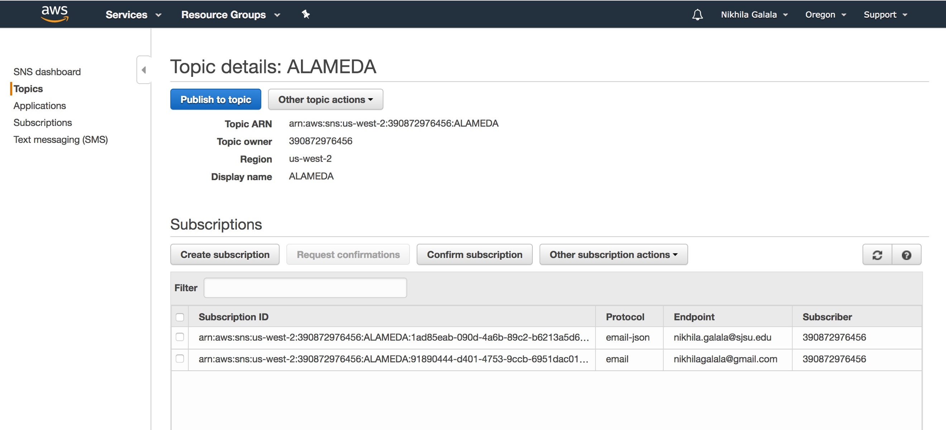
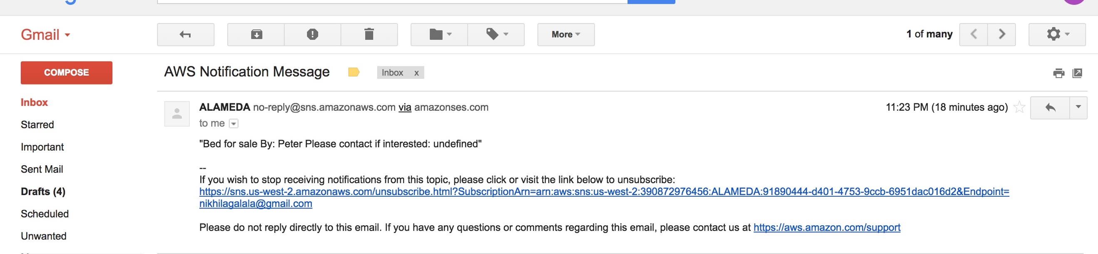

AWS SNS Implementation

Slide 20
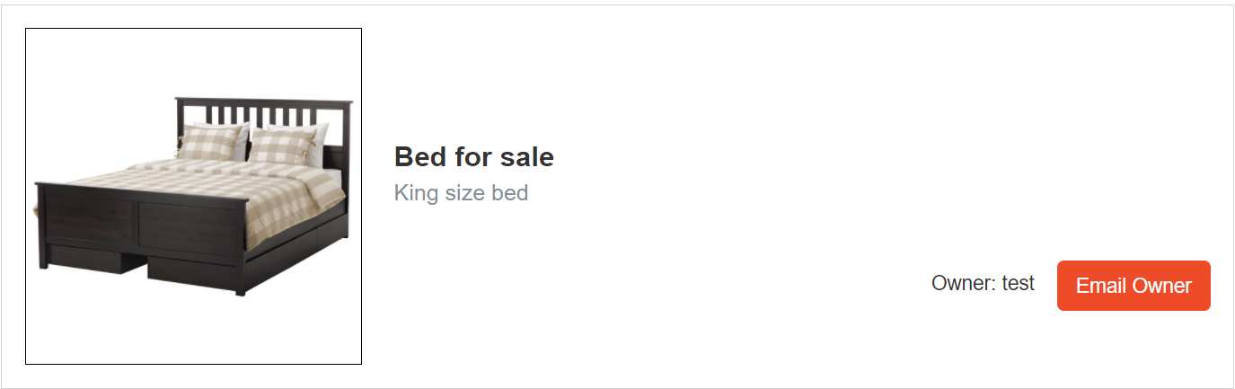
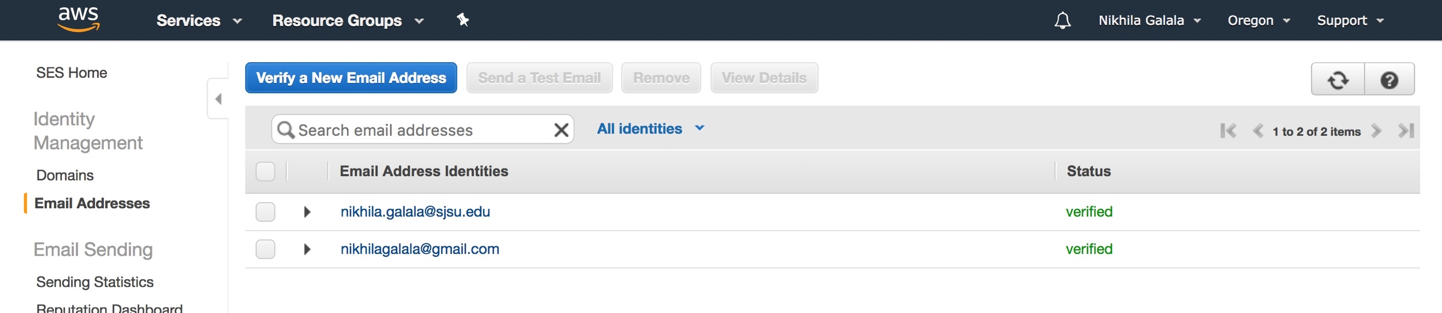
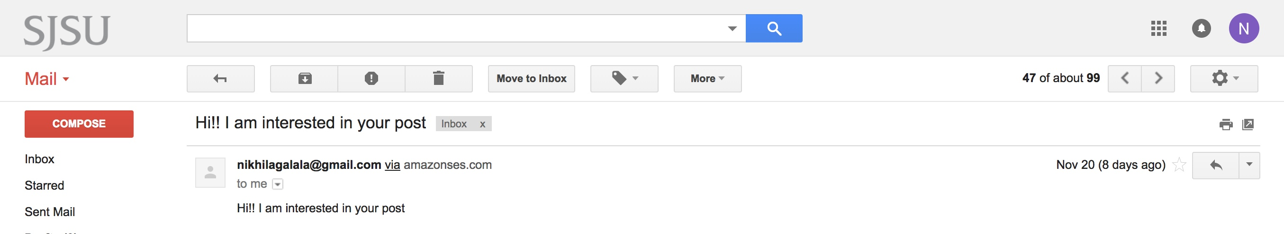

AWS SES Implementation

Slide 21
JUSTIFICATIONS
We have used the following cloud components in our project for designing a neighborhood:
AWS SNS for inter community communication
AWS SES for intra community communication
AWS S3 for storing project files
AWS RDS with MySQL as a DB component

Slide 22
Other Technologies
NodeJS: NodeJS is used to create RESTful services in our application.
ExpressJS: Used ExpressJS along with NodeJS as it is a light weight web application development framework.
Jquery: Used Jquery for DOM Manipulation
HTML and CSS: Used these technologies to develop the Front End of our application.
MySQL: To store the community posts and user data.

Slide 23
PROJECT STATUS/PROGRESS
Implemented the Following Components:
Community Management Component
Dashboard Component
DB Component
Work flow service component
Messaging Component
80% of Integration of all the components is done and 20% is pending.

Slide 24
THANK YOU!

